Slide 1
ORM and Entity Framework

Slide 2
Agenda
Object Relational Mapping (ORM)
What is Entity Framework?
Entity Framework Architecture
Create First Entity Data Model (EDM)
Querying with EDM
Data Manipulation with DBContext
Q&A

Slide 3
Object Relational Mapping (ORM) – Why?
Convert wrong data type is often happen in ADO.NET that’s reason ORM is invented to resolve this problem and others
Simplified development because it automates object-to-table and table-to-object conversion, resulting in lower development and maintenance costs
Less code compared to embedded SQL and handwritten stored procedures
Transparent object caching in the application tier, improving system performance
An optimized solution making an application faster and easier to maintain
Notes:
ORM ra đời nhằm giải quyết bài toán về object mapping giửa table-to-object và object-to-table, tránh những lổi ko cần thiết khi convert data từ DataReader tới object

Slide 4
What is Entity Framework (EF)?
EF is an implementation of ORM in .Net
EF Features
  Provides mechanism for accessing and storing the data to database
  Provides services as change tracking, lazy loading, query translation…etc
  Using LINQ to Entities for CRUD operations (Create, Read, Update, Delete)
  Improves maintainable and extendable for application
    Separate database design and domain class design
    Multiple database support such as SQL server, Oracle...etc

Slide 5
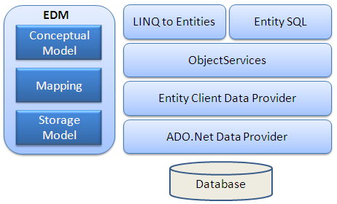
Entity Framework Architecture
Notes:
EDM (Entity Data Model): EDM consist three main parts- Conceptual model, Mapping and Storage model.
Conceptual Model: Conceptual model is your model classes and their relationships. This will be independent from your database table design.
Storage Model: Storage model is your database design model which includes tables, views, stored procedures and their relationships and keys.
Mapping: Mapping consist information about how your conceptual model is mapped to storage model.
LINQ to Entities:LINQ to Entities is query language used to write queries against the object model. It returns entities which are defined in the conceptual model.
Entity SQL:Entity SQL is again a query language same as LINQ to Entities. However it is little more difficult than L2E and also developer need to learn it separately.
Object Service:Object service is a main entry point for accessing data from database and to return it back. Object service is responsible for materialization which is process of converting data returned from entity client data provider (next layer) to an entity object structure.
Entity Client Data Provider:The main responsibility of this layer is to convert L2E or Entity SQL queries into SQL query which is understood by underlying database. It communicates with ADO.Net data provider which in turn sends or retrieves data from database.
ADO.Net Data Provider:This layer communicates with database using standard ADO.Net.

Slide 6
Database First
Executed Steps:
  Create Database Schema
  Create New Project and EDM
  EDM Configurations
  EDM Generation
Notes:
Entity Data Model (EDM) is used to create for Database First

Slide 7
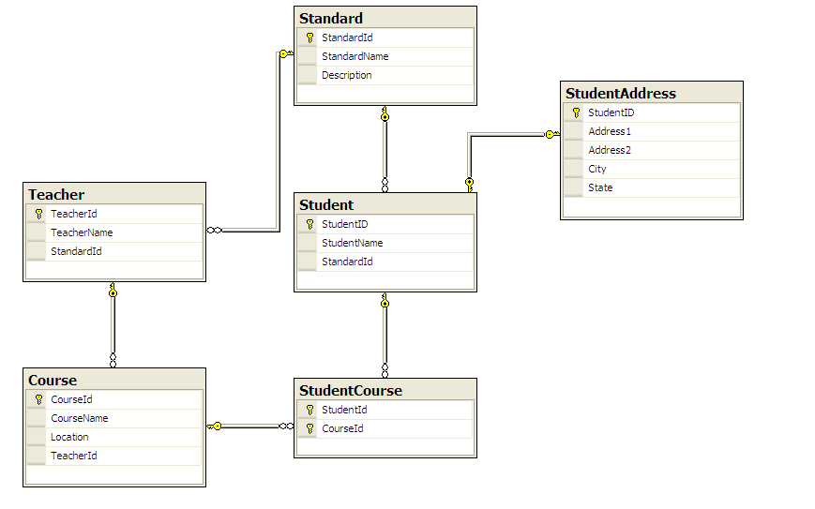
Create Database Schema

Slide 8
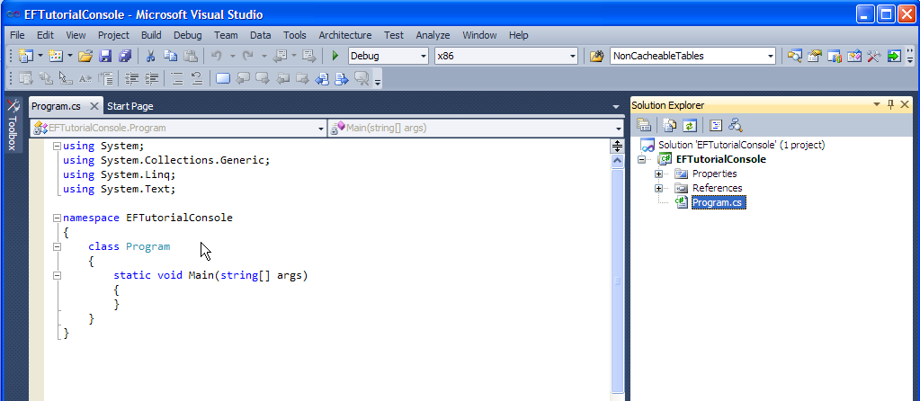
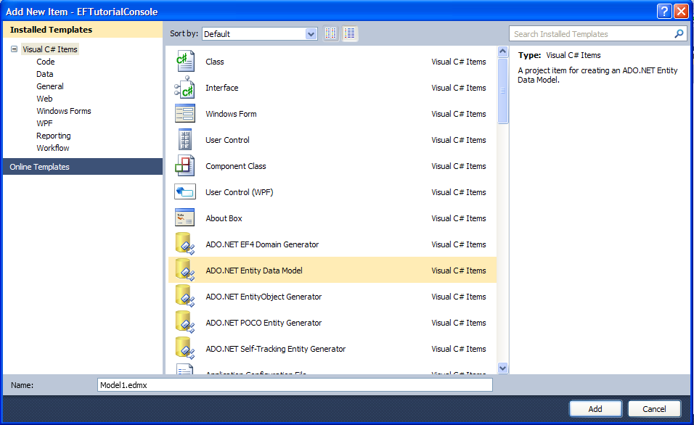
Start New Project and EDM
Create console project with named EFTutorialProject
Right click on ‘EFTutorialProject’ and go to Add -> New Item and select ADO.NET Entity Data Model from the popup and click "Add“

Slide 9
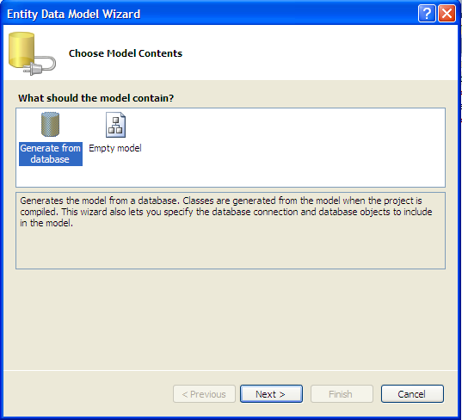
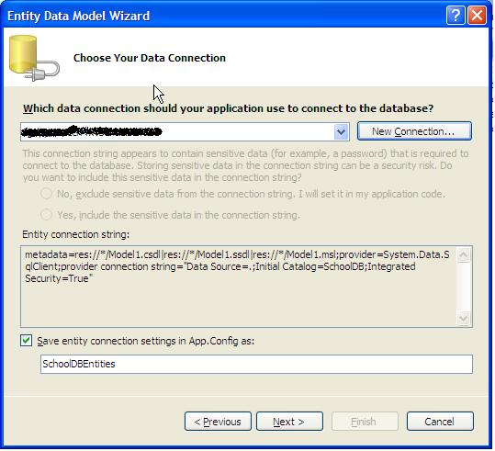
EDM Configurations
It opens Entity Data Model Wizard. Select ‘Generate from database’ option and click ‘Next’
Create new connection by clicking ‘New Connection’ button

Slide 10
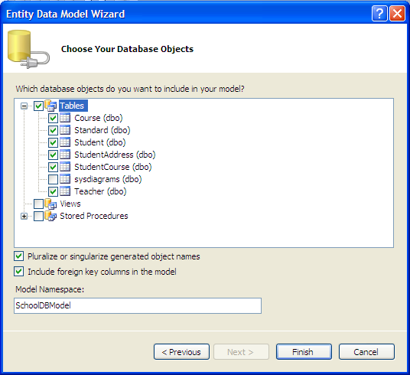
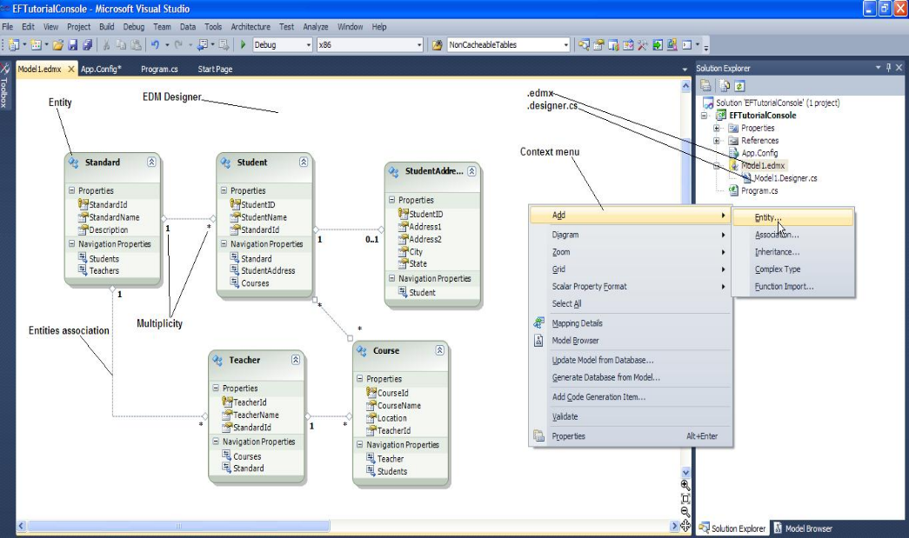
EDM Generation
This step will display all the Tables, Views and Stored Procedures in the database. Select tables, views and SPs you want and click ‘Finish
After clicking on ‘Finish’, it will add Model1.edmx file into your project

Slide 11
Querying with EDM
Linq to Entities
Entity SQL
Native SQL

Slide 12
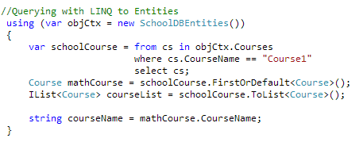
Querying with EDM
LINQ to Entities
Output:
  mathCourse variable is an instance of Course object
  courseList variable is an instance of list of Course object
Notes:
Trước tiên, bạn phải tạo ra đối tượng của lớp bối cảnh đó là SchoolDBEntities. Bạn nên khởi tạo nó trong “using()" để khi nó đi ra khỏi phạm vi thì nó tự động sẽ gọi Dispose() phương pháp của lớp ngữ cảnh. Bây giờ, bạn có thể sử dụng LINQ với đối tượng bối cảnh. LINQ truy vấn sẽ trở lại IQueryable <> đối tượng nhưng loại cơ bản của var sẽ ObjectQuery. Sau đó bạn có thể nhận được đối tượng duy nhất sử dụng FirstOrDefault <> () hoặc danh sách các đối tượng bằng cách sử dụng ToList <> ().

Slide 13
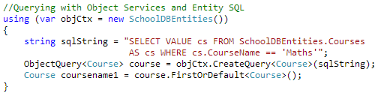
Querying with EDM
Entity SQL
Output:
  coursename1 variable is an instance of Course object
Notes:
Ở đây cũng có, bạn phải tạo ra đối tượng của lớp ngữ cảnh. Bây giờ bạn phải viết truy vấn SQL theo cú pháp SQL để thực thể và vượt qua nó trong CreateQuery <> () của đối tượng đó. Nó sẽ trở lại ObjectQuery> kết quả <. Sau đó bạn có thể sử dụng đối tượng duy nhất FirstOrDefault <> () hoặc danh sách các đối tượng bằng cách sử dụng ToList <> ().

Slide 14
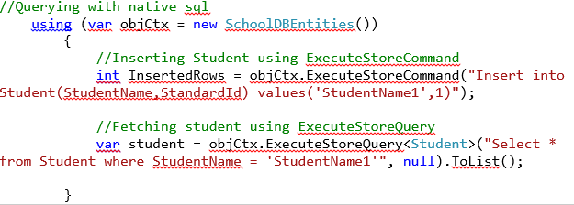
Querying with EDM
Native SQL
Output:
  student variable is an instance of list of Student object
Notes:
Bản địa SQL Trong khung Entity v4 phương pháp mới ExecuteFunction (), ExecuteStoreQuery () và ExecuteStoreCommand () đã được thêm vào ObjectContext lớp. Vì vậy, bạn có thể sử dụng những phương pháp để thực hiện bản địa SQL vào cơ sở dữ liệu như tren

Slide 15
Querying with EDM
Notes
Entity SQL and Native SQL are not recommend to use, because it will hard for maintaining or database changing in the future

Slide 16
Data Manipulation with Linq to Entity

Slide 17
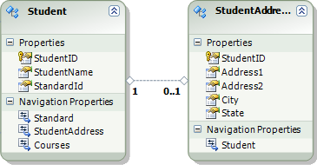
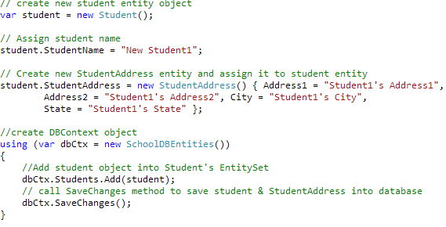
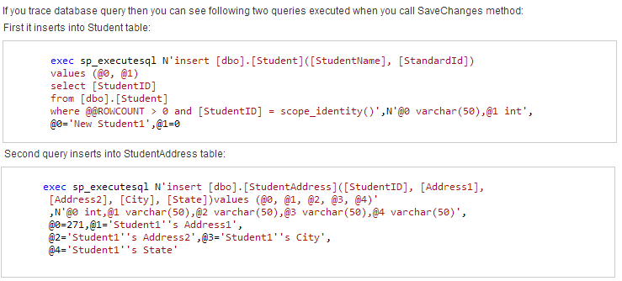
Add One-to-One Relationship Entity Graph using DBContext
1
2
Entity Data Model
Code
3
Notes:
Demo này sử dụng DBContext để add new record tới Student table. Chú ý các bước 1->2->3

Slide 18
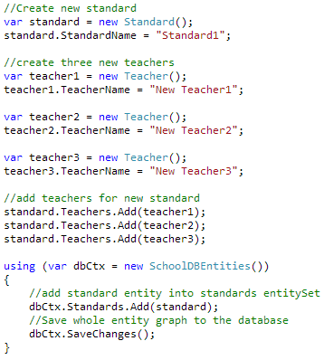
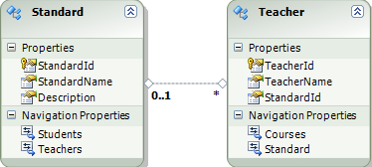
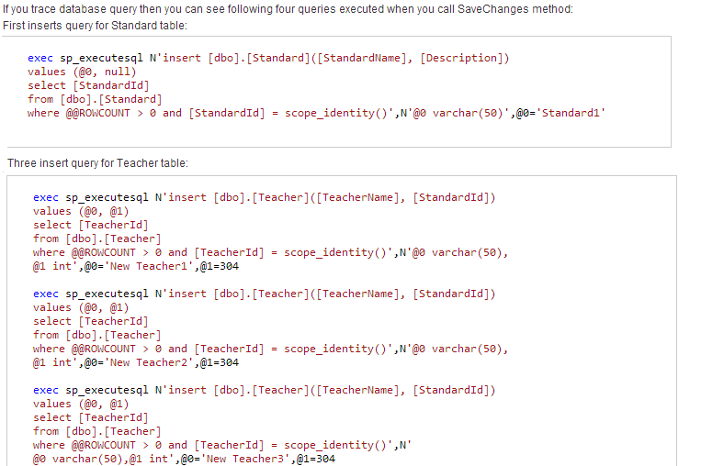
Add One-to-Many Relationship Entity Graph using DBContext
1
Entity Data Model
Code
2
3
Notes:
Chú ý các bước 1->2->3

Slide 19
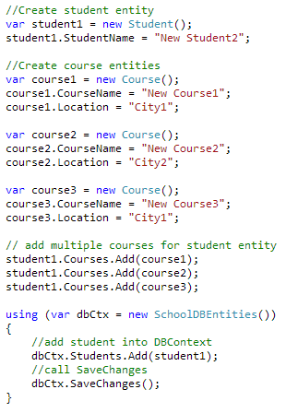
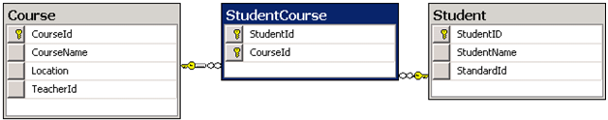
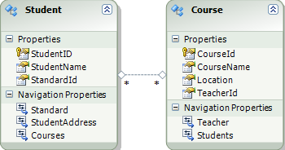
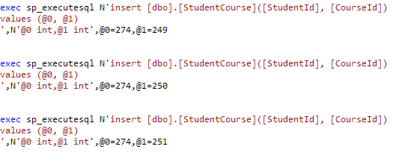
Add Many-to-Many Relationship Entity Graph using DBContext
1
2
Database Schema
Entity Data Model
Code
3
Notes:
Chú ý các bước 1->2->3

Slide 20
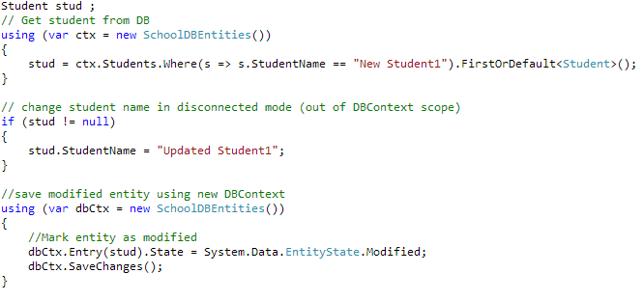
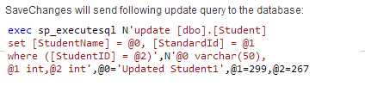
Update Entity using DBContext
Notes:
Chú ý các bước 1->2->3

Slide 21
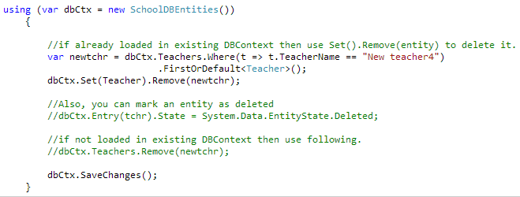

Delete Entity using DBContext

Slide 22
End of Database First

Slide 23
Code First
Code First

Slide 24
Code First
Agenda
  What is Code-First
  Database Initialization
  Simple Code-First Example
  Configure Domain Classes in Code-First
  DataAnnotation
  Configure One-to-One
  Configure One-to-Many
  Configure Many-to-Many

Slide 25
What is Code-First
Code First was introduced in Entity Framework 4.1 and mainly useful in Domain Driven Design
Focus on the domain design and start creating classes as per your domain requirement rather than design your database First approach
Code First APIs will create the database on the fly based on your entity classes and configuration
So the basic workflow would be:
  Write code-first application classes → Hit F5 to run the application → Code First API creates new database or map with existing database from application classes → Inserts default/test data into the database → Finally launch the application
Notes:
http://msdn.microsoft.com/en-us/data/dd363565.aspx

Slide 26
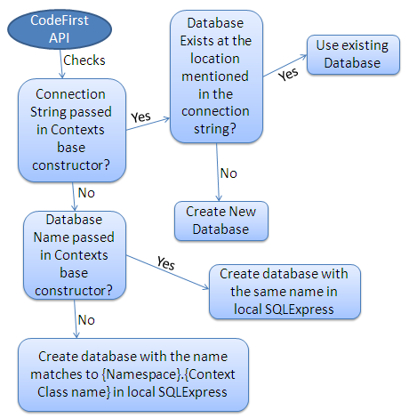
Database Initialization
Let’s how database initialize in code-first application.
Following figure shows database initialization workflow based on the parameter passed in base constructor of context class which is derived from DbContext

Slide 27

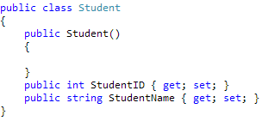
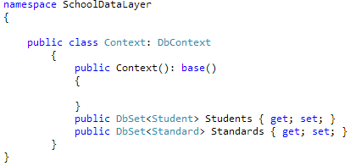
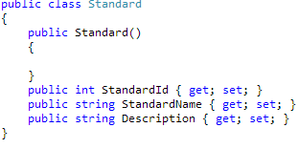

Simple Code-First Example
1
2
3
Notes:
tạo 2 đối tượng là Student và Standard class trước
Sau đó tạo DBContext va cuối cùng là sử dụng
A DbContext instance represents a combination of the Unit Of Work and Repository patterns such that it can be used to query from a database and group together changes that will then be written back to the store as a unit. DbContext is conceptually similar to ObjectContext

Slide 28
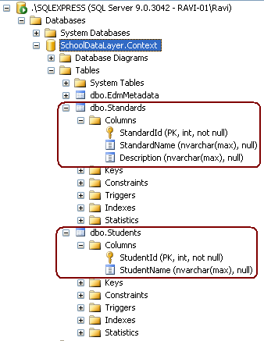
Simple Code-First Example
Code-first API will also create two tables in the database, Students and Standards table based on Student and Standard class. Code First APIs creates PrimaryKey in the table if class has either “Id” or ClassName + “Id” property. For example, Student class has “StudentId” property so it will create StudentId as PK column. It will also create other columns with the same name and datatype as property names and datatype as below.

Slide 29
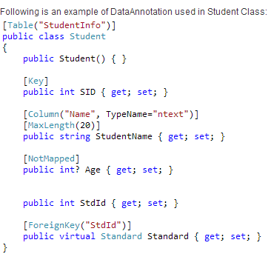
Configure Domain Classes in Code-First
Notes:
Xem slide sau để giải thích them về DataAnnotation

Slide 30
DataAnnotation in Code-First
Validation Attributes
Annotation Attribute | Description
Required | The Required annotation will force EF (and MVC) to ensure that property has data in it.
MinLength | MinLength annotation validates property whether it has minimum length of array or string.
MaxLength | MaxLength annotation maximum length of property which in-tern set maximum length of column in the database
StringLength | Specifies the minimum and maximum length of characters that are allowed in a data field.

Slide 31
DataAnnotation in Code-First
Database Schema related Attributes
Database Schema related Attributes:
Annotation Attribute | Description
Table | Specify name of the DB table which will be mapped with the class
Column | Specify column name and datatype which will be mapped with the property
Key | Mark property as EntityKey which will be mapped to PK of related table.
ComplexType | Mark the class as complex type in EF.
Timestamp | Mark the property as a non-nullable timestamp column in the database.
ForeignKey | Specify Foreign key property for Navigation property
NotMapped | Specify that property will not be mapped with database
ConcurrencyCheck | ConcurrencyCheck annotation allows you to flag one or more properties to be used for concurrency checking in the database when a user edits or deletes an entity.
DatabaseGenerated | DatabaseGenerated attribute specifies that property will be mapped to Computed column of the database table. So the property will be read-only property. It can also be used to map the property to identity column (auto incremental column).
InverseProperty | InverseProperty is useful when you have multiple relationship between two classes.

Slide 32
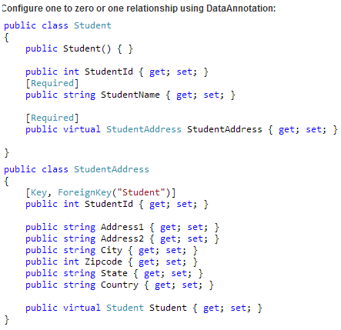
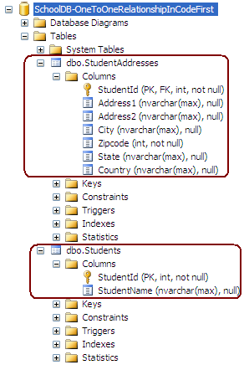
Configure One-to-One Relationship
1
2

Slide 33
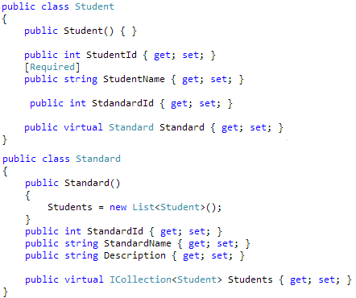
Configure One-to-Many Relationship
1
2

Slide 34
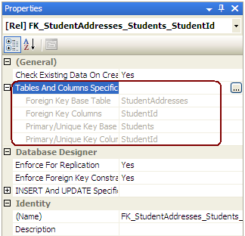

Slide 35
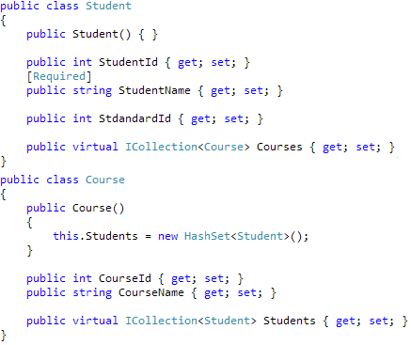
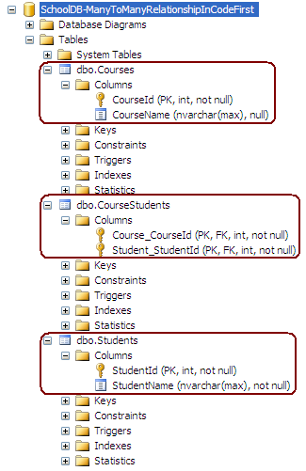
Configure Many-to-Many relationship
1
2

Slide 37
References
Basic Entity Framework
  http://www.entityframeworktutorial.net/EntityFramework4.3/Introduction.aspx
Code First Tutorial
  http://www.entityframeworktutorial.net/code-first/entity-framework-code-first.aspx
Ebooks
  http://1drv.ms/1goxfRZ

Slide 38
Question & Answer
Notes:
http://msdn.microsoft.com/en-us/data/dd363565.aspx

